Slide 1
Anxiety
Olivia Anacleto, Raquel Levy, Sarah Tedford

Slide 2
What is Anxiety?
Photo by Usman Yousaf on Unsplash
Photo by Solen Feyissa on Unsplash

Slide 3
Let’s play a game!
What percent of Canadian children do you think experience anxiety?
~100%
?

Slide 4
Shocked?
You were probably thinking of an anxiety disorder!

Slide 5
3 terms to understand when
talking about anxiety
Stress
Anxiety
Anxiety Disorders
A physical, emotional or
mental state of tension. Stress is a feeling that is a normal part of life. (Duvall & Roddy 2021)
Constant stress and
excessive worry about real and/or imagined circumstances. Students with anxiety
are consumed with perceived future threats. (Duvall & Roddy 2021)
Anxiety disorders are a group of mental illnesses involving excessive anxiety.
(CMHA 2018)

Slide 6
A list of Common Anxiety Disorders:
Panic disorder
Agoraphobia
Generalized anxiety disorder
Phobias
Selective mutism
Social phobia or social anxiety disorder
Separation anxiety disorder
(Canadian Mental Health Association 2018)
Notes:
Generalized anxiety disorder—Excessive worry that comes up often and is difficult to control.
Panic disorder—Recurring panic attacks and fears about having more panic attacks. (A panic attack is a period of sudden, intense fear that peaks quickly.)
Agoraphobia—An intense fear of having a panic attack outside the home and being unable to leave or escape, leading to avoidance of spaces like school, public transportation, or large crowds.
Phobias—Intense and unrealistic fears of a specific object, situation, or event.
Social phobia or social anxiety disorder—An intense fear of social situations.
Separation anxiety disorder—Extreme anxiety when separated or expecting to be separated from parents or caregivers.
Selective mutism—Consistently refusing to speak in specific situations.

Slide 7
With that said...
What percent of Canadian children do you think experience an anxiety disorder?
~3%
However, this statistic only represents students diagnosed with anxiety disorders...
?
(Canadian Mental Health Association 2018)

Slide 8
Realistically…
Anxiety is one of the most common mental health concerns for children and adults, affecting upwards of 20% of children and adolescents over the lifespan.
(Anxiety Canada 2020)

Slide 9
How to Recognize Anxiety in Students
Notes:
Now we are going to talk about to how recognize anxiety in students. This will be about the ways it is presented and the signs teachers can use to recognize when one of their students may have anxiety.

Slide 10
How many of us have taught a student with anxiety?
Notes:
First, I have a question for you all. How many of you believe you have taught a student with anxiety? If you could please use a zoom reaction button, that’d be great.
I am going to come back to this and ask again after we talk about ways anxiety is presented to see if anyones thoughts have changed. Maybe some of you who did not know before, will realize that you may have actually taught a student with anxiety.

Slide 11
Signs of Anxiety
Difficulties in school
Attendance problems
Physical complaints
Avoidance of certain things
Photo by Caleb Woods on Unsplash
Notes:
Anxiety in students can sometimes be hard to detect because there are so many different kinds and so many ways that it may be presented. “Anxiety tends to lock up the brain”, making school hard for these children. Some ways anxiety may be presented that the teacher will be able to observe are:
Difficulties in school, such as problems concentrating, restlessness, trouble answering questions or speaking in class, disruptive behavior in class, and not turning in homework.
Attendance problems, where kids may refuse to go to school, participate in activities or see friends. They may also be very clingy and become upset when their parents leave.
Another sign is physical complaints, like stomach aches, headaches, shakiness, or dizziness, which can result in several trips out of class to go to the nurse for not feeling well.
Avoidance is another common sign of anxiety, where the student may avoid certain things or situations, like dogs, socializing, group work, or large crowds
There are many signs of anxiety, and these are some of the more common ones. Some others include...

Slide 12
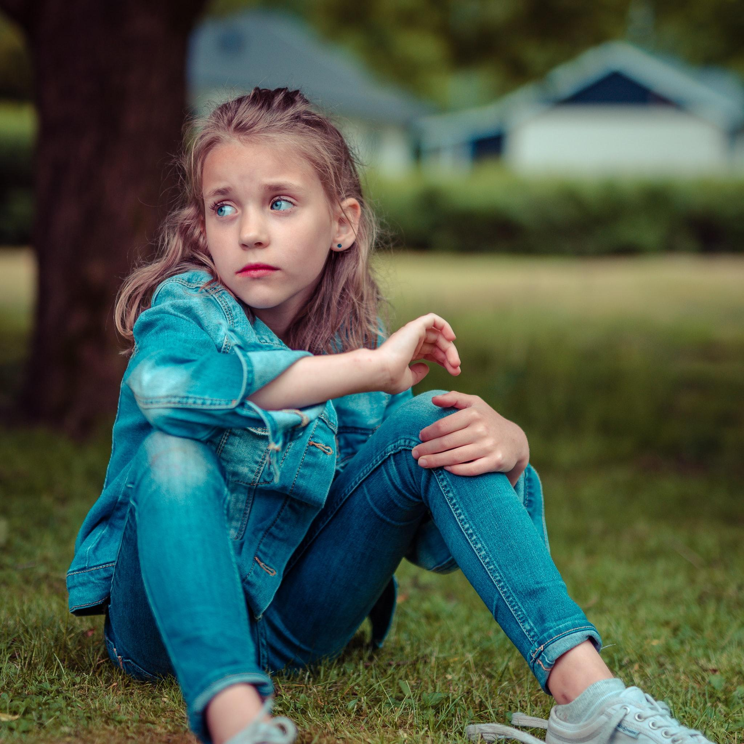
More Signs
Difficulty sleeping or eating
Very concerned
Frequent panic attacks
Seek reassurance
Upset over minor problems
Photo by Janko Ferlič on Unsplash
Notes:
Difficulties sleeping well or eating well. This is one that the teacher may not be able to see directly, but they will be able to notice if the student often seems very tired
Expressing a lot of concerns or asking a lot of “What if…?” questions. This comes with over thinking situations and needing to know what will happen or what could happen
Having panic attacks more than occasionally
Often seeking reassurance that everything will be okay
Becoming very upset over minor problems or conflicts. When there is a change or something does not go the way they planned or thought, a student with anxiety can become upset
These signs of student anxiety are also fairly common. They are ones that may or may not be seen at school by the teacher. Some, like panic attacks or getting upset, for example, may happen more at home than at school, but it is still possible that if a student becomes very anxious, these signs will be presented.

Slide 13
Again...
Do you think you have taught a student with anxiety now that you know and are able to recognize the signs and how it is presented?
Notes:
Based on the signs we just discussed, I am going to ask the previous question again. Do you think you have taught a student with anxiety now that you know and are able to recognize the signs and how it is presented?

Slide 14
What can you do as a teacher?
To help students who may be struggling with anxiety.

Slide 15
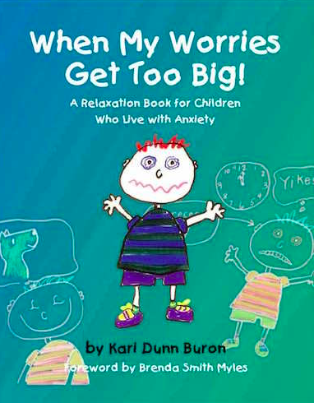
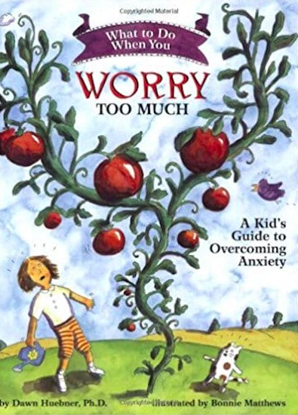
Talk Openly About Anxiety With Your Students
K - 3
Pre K - 2
Grade 1 - 6
Notes:
Talk about anxiety openly with your students can help them learn how to recognize anxiety so they know how to approach it and regulate their emotions. Using story books are a great way to introduce this topic to students at all grade levels. Here are a few book titles to help teach students about anxiety.

Slide 16
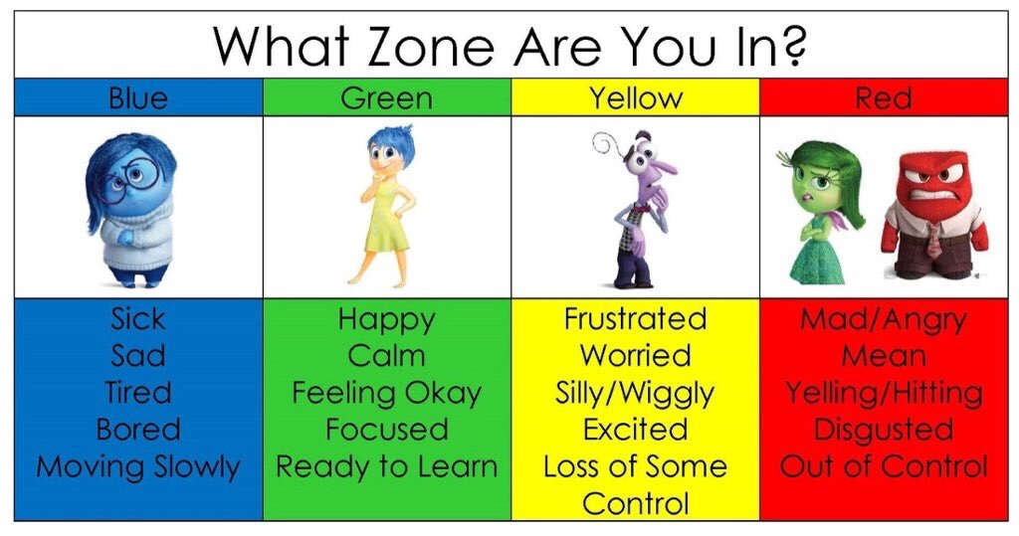
Remember that responses to anxiety vary!
https://sheila-vick.com/2018/01/07/self-reg-and-the-zones-of-regulation/
Notes:
I’m sure some of you guys have seen the zones of regulation as a tool to help students regulate their emotions. It is important to remember that every student will respond to anxiety differently. When a student is feeling anxious, some may feel like they are in the blue zone, which is sad or tired. Other may feel like they are in the yellow zone - frustrated or worried, and some may feel in the red zone - mad/ angry. Remembering that every student will respond to anxiety differently, and being able to recognize this can help you learn how to identify it!

Slide 17
Emotional Regulation
Just a few tips to help children regulate anxiety.
Notes:
There are lots of emotional regulation and mindfulness strategies that can be implemented in the classroom or pe environment. If you recognize a student may be struggling with anxiety, try implementing some of these strategies in the classroom. However, you do not only need to incorporate these is you suspect a student may be struggling with anxious thoughts in the classroom. These are great to include as a part of the classroom routine to teach students how to regulate their emotions and deal with anxious thoughts if they do come up.

Slide 18
Rainbow Breaths
Let’s try some rainbow breaths together!
Notes:
Slow, deep breaths can help students slow down their brains. By taking the whole class through guided breathing exercises as a part of the classroom routine, they can learn how to use this strategy when they may be feeling anxious.
Let’s try some rainbow breaths together!

Slide 19
Get Outside!
How many different kinds of trees do you see?
What sounds can you hear?
Photo by Mike Benna on Unsplash.
Notes:
-Being in nature can help calm a student who may be experiencing anxiety.
-Ask them questions! This can help them observe the environment and turn their worries to thinking about something else.

Slide 20
Gratitude Journal
Encouraging students to think positive can sometimes shift their negative thoughts.
Have students keep a gratitude journal! If you notice they may be overwhelmed or may be feeling anxious, encourage them to re-read what they wrote for some positivity!
What is something you are thankful for? Add it to the chat!
Notes:
-Helping students think positive can sometimes shift their negative thoughts.
-Have students keep a gratitude journal - If you notice they may be overwhelmed or may be feeling anxious, encourage them to re-read what they wrote to bring in some positivity!
-What is something you are thankful for? Add it to the chat!

Slide 21
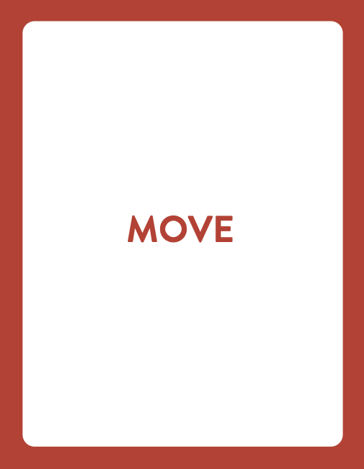
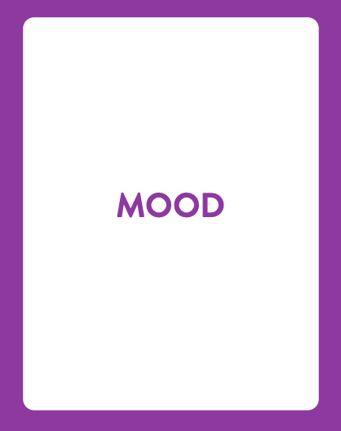
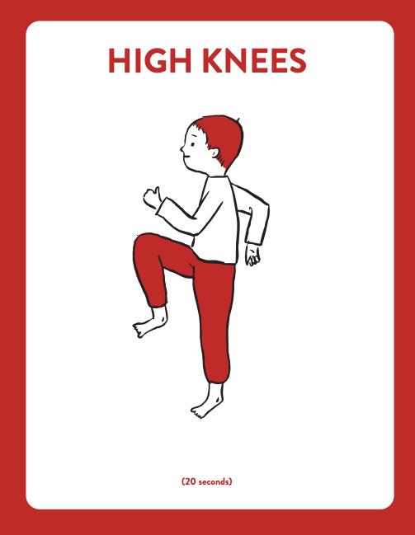
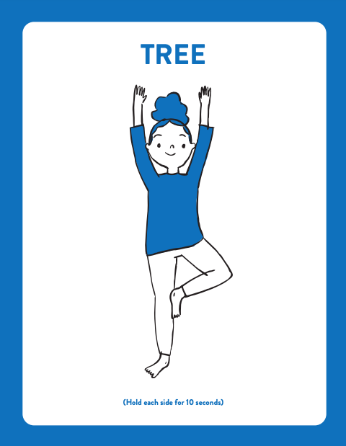
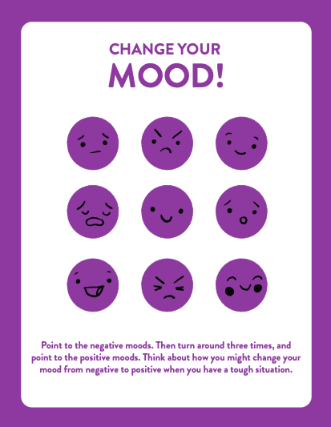
Get Kids Moving
https://www.weareteachers.com/wellness-way/
Notes:
Get Kids Active! - This is where PE comes into play! As we learned about in the course, exercise is a great emotional regulation technique and can help students who may be struggling with anxiety. By getting kids moving, they can release some tension and shift their negative thoughts to positive ones. Additionally, as I mentioned when referencing the zones of regulation, students express anxiety in various ways, some of which may be anger. So, if you see students demonstrating anger, or frustration, a movement break can help thing get out of the red zone and into the green zone!
On this slide, I’ve included some printables from a resource called the Wellness Way. There are different posters that can be placed around the walls of a gym, or a classroom, to promote mindfulness and getting the students’ body moving. The red cards get students moving, the blue cards get them recharged and ready to learn, and the purple cards promote positive affirmation and mindfulness.. The resource to download these printable are free and they are a fun way to bring movement and mindfulness into the classroom!

Slide 22
Moving Forward...
Teachers are the trusted adult for children for about 25-30 hours a week. With that said, it is our responsibility to be understanding of anxiety disorders and other mental health problems that our students may need to manage.
The best way to help students with anxiety is to create a classroom environment that welcomes open conversation about mental health. Educate your students about these problems and make sure that they know that you are open to collaborating with them to discover what you can do to help them.

Slide 23
References
10 best children books to help kids with anxiety. (n.d.). Educate 2 Empower Publishing. Retrieved March 05, 2021, from https://e2epublishing.info/blog/10-best-books-anxiety
Anxiety Canada. (2020, October 29). Retrieved March 05, 2021, from https://www.anxietycanada.com/
Canadian Mental Health Association. Children, youth, and anxiety. (2018, December 06). Retrieved March 05, 2021, from https://cmha.ca/documents/children-youth-and-anxiety
Cole, S. (2018, August 27). 15 books that may help students with anxiety. We Are Teachers. https://www.weareteachers.com/books-for-kids-with-anxiety/
Duvall, A., & Roddy, C. (2020). Managing anxiety in school settings: Creating a survival toolkit for students. Routledge.
Ehmke, R. Anxiety in the classroom. Child Mind Institute. https://childmind.org/article/classroom-anxiety-in-children/.
McKibben, S. (2017, August). Helping ease student anxiety. ASCD. http://www.ascd.org/publications/newsletters/education-update/aug17/vol59/num08/Helping-Ease-Student-Anxiety.aspx.
Nelson, K. (2019, October 01). 10 ways to help students who struggle with anxiety. We Are Teachers. https://www.weareteachers.com/help-students-with-anxiety/
Think Social Publishing. (2019, November 1). 14 tips to help all kids learn to manage anxiety. Socially Thinking Articles. https://www.socialthinking.com/Articles?name=14-tips-help-kids-manage-anxiety
Tornio, S. (n.d.). Encourage creative movement in the classroom with free wellness way printable. WE Are Teachers. https://www.weareteachers.com/wellness-way/

